Slide 1
Chapter 1 Introduction to Windows Server
Applications | Security Concepts | Services | Architecture

Slide 2
History of Windows Server
Major main releases from Windows NT Advanced Server to Windows Server 2025
NT Server era • 1993–2000
Windows Server brand • 2003–2013
Modern LTSC era • 2016–2025
Early releases and first Windows Server editions
R2 and modern Windows Server releases
Release
General availability date
Release
General availability date
Windows NT 3.1 Advanced Server
27 July 1993
Windows Server 2008 R2
22 October 2009
Windows NT 3.5 Server
21 September 1994
Windows Server 2012
4 September 2012
Windows NT 3.51 Server
30 May 1995
Windows Server 2012 R2
17 October 2013
Windows NT 4.0 Server
24 August 1996
Windows Server 2016
12 October 2016
Windows 2000 Server
17 February 2000
Windows Server 2019
2 October 2018
Windows Server 2003
24 April 2003
Windows Server 2022
18 August 2021
Windows Server 2003 R2
5 March 2006
Windows Server 2025
1 November 2024
Windows Server 2008
27 February 2008
Brand shift: Microsoft introduced the “Windows Server” name with Windows Server 2003.
Source: Wikipedia, “Windows Server” — Main releases list. Accessed 20 June 2026.

Slide 3
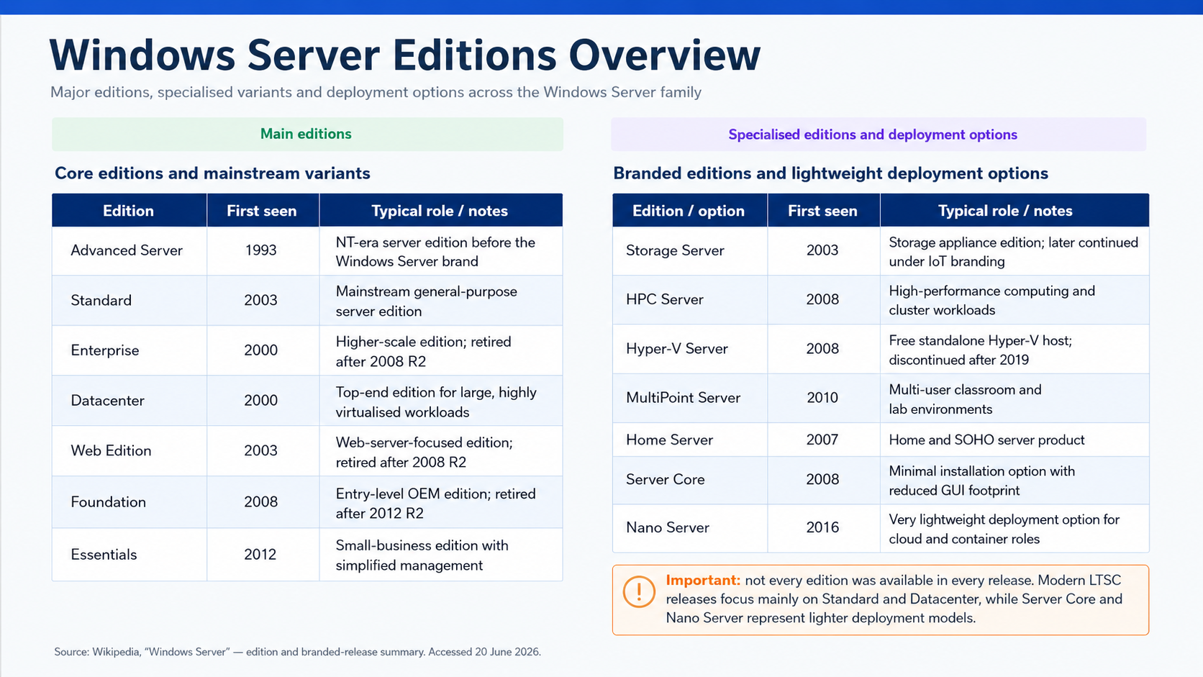

Slide 4
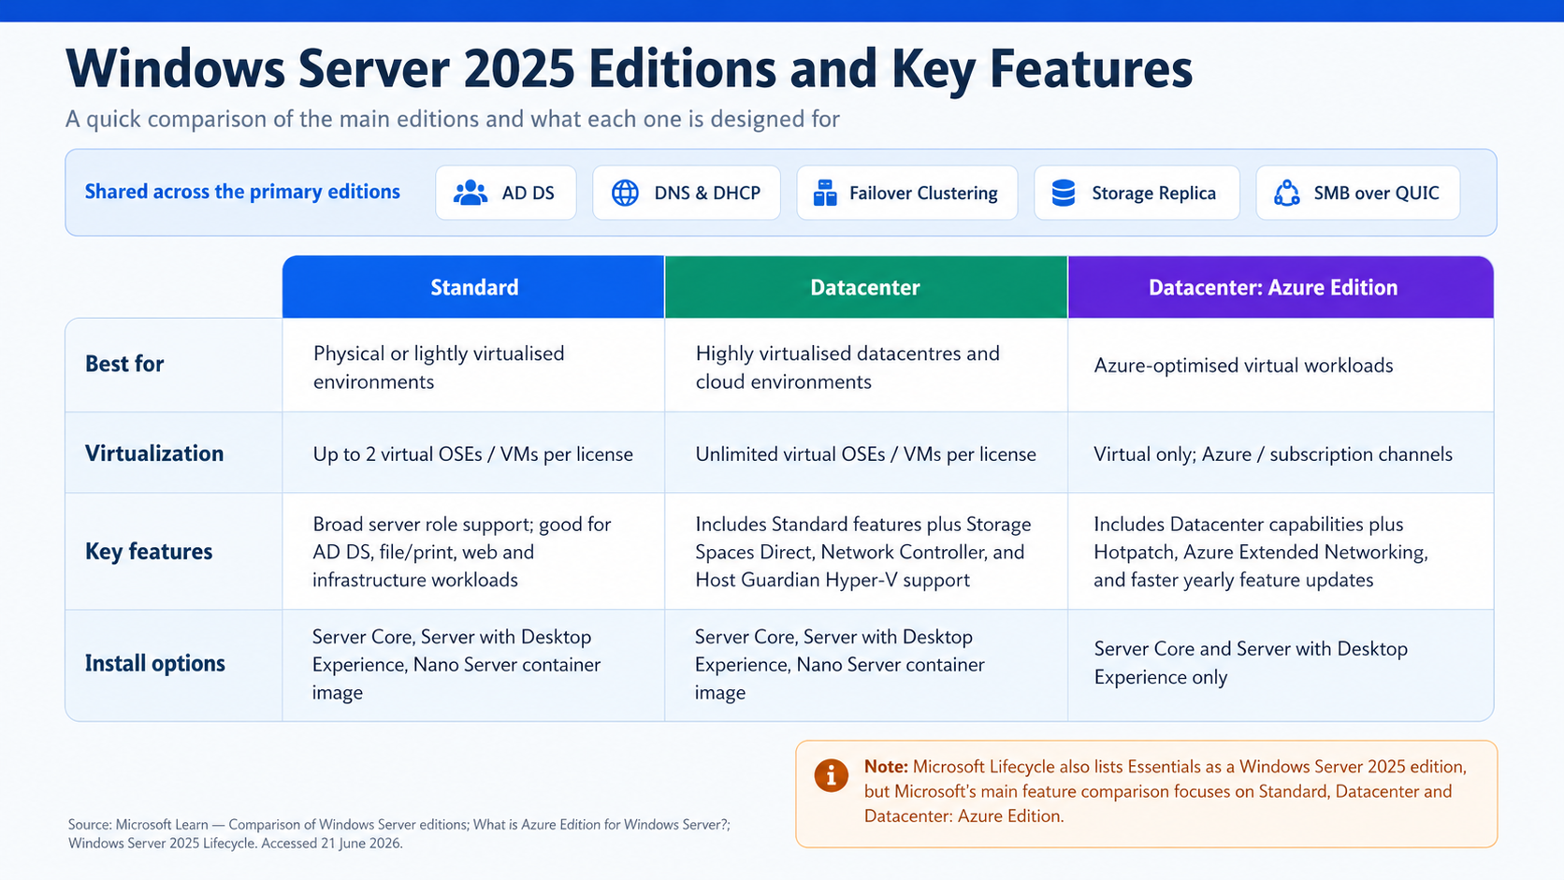

Slide 6
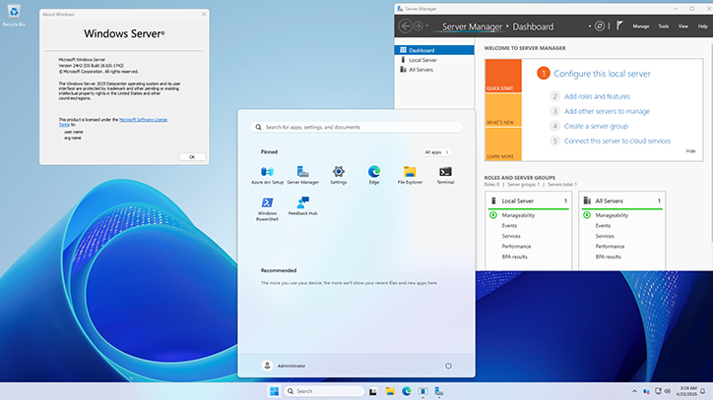
Windows Server 2025
Windows Server 2025 | Chapter 1: Introduction to Windows Server
02

Slide 7
Learning Objectives
01 Explain Windows Server as an application and workload platform
02 Describe core Windows Server security concepts
03 Identify how services underpin server operations
04 Connect platform design choices to later administration topics
05 Explain the high-level architecture of the Windows Server platform
Windows Server 2025 | Chapter 1: Introduction to Windows Server
03

Slide 8





Windows Server 2025
A platform for infrastructure roles and business workloads
Designed for remote administration and automation
Built for on-premises, virtualized, and hybrid environments
Available in editions and installation models that affect operations and supportability
Management & Security
Applications & Services
Roles & Features
Windows Server OS
Hardware or VM
Windows Server 2025 | Chapter 1: Introduction to Windows Server
04

Slide 9
Topic 1.1 | Applications and Roles

Slide 10
1.1 Applications: What This Means in Windows Server
Hosts infrastructure, web, API, and business application workloads
Extended through roles and features — not just app installers
Edition and installation model affect supportability
Workload design must include identity, networking, storage, and patching
Common examples: IIS-hosted apps, line-of-business services, management agents, certificate-dependent workloads
Windows Server 2025 | Chapter 1: Introduction to Windows Server
07

Slide 11
Application Platform Layers
Operating system platform
Roles and features
Runtime or middleware layer
Management layer
Security layer
Problems at one layer often appear as symptoms at another
OS Platform
Roles & Features
Application Runtime
Management Tools
Security Controls
Problems at one layer appear as symptoms at another
Windows Server 2025 | Chapter 1: Introduction to Windows Server
08

Slide 12
Windows Server Roles (1 of 2)
Role | PowerShell Name | Default?
Active Directory Certificate Services | AD-Certificate | No
Active Directory Domain Services | AD-Domain-Services | No
Active Directory Federation Services | ADFS-Federation | No
Active Directory Lightweight Directory Services | ADLDS | No
Active Directory Rights Management Services | ADRMS | No
Device Health Attestation | DeviceHealthAttestationService | No
DHCP Server | DHCP | No
DNS Server | DNS | No
File and Storage Services | FileAndStorage-Services | Yes
Host Guardian Service | HostGuardianServiceRole | No
Windows Server 2025 | Chapter 1: Introduction to Windows Server
09

Slide 13
Windows Server Roles (2 of 2)
Print and Document Services | Print-Services | No
Remote Access | RemoteAccess | No
Remote Desktop Services | Remote-Desktop-Services | No
Volume Activation Services | VolumeActivation | No
Web Server IIS | Web-Server | No
Windows Server Essentials Experience | ServerEssentialsRole | No
Windows Server Update Services | UpdateServices | No
Windows Server 2025 | Chapter 1: Introduction to Windows Server
10

Slide 14
Application Administration Workflow
1
2
3
4
5
Choose edition & install option
Install required roles & features
Configure networking, identity, certs
Deploy the workload
Validate monitoring, patching & recovery
▶
▶
▶
▶
# Check and install IIS
Get-WindowsFeature Web-Server, NET-Framework-45-Features
Install-WindowsFeature -Name Web-Server -IncludeManagementTools
Prefer repeatable builds and PowerShell over manual GUI workflows
Use IIS as the representative example. Emphasise that good server administration starts with workload requirements — not with clicking around the GUI.
Windows Server 2025 | Chapter 1: Introduction to Windows Server
11

Slide 15

Applications: Key Teaching Points
Workload Platform
Roles & Features
Windows Server is a managed workload platform, not just an OS
Roles and features define hosted capabilities — only install what's needed
Server Core
Supportability
Server Core reduces attack surface and management overhead
Deployment decisions affect supportability, security, and troubleshooting
Windows Server 2025 | Chapter 1: Introduction to Windows Server
12

Slide 16
Server Core vs Desktop Experience
Server Core
Desktop Experience
GUI: No graphical interface — command line & PowerShell only
Full Windows GUI with Start menu, taskbar, and Explorer
Footprint: ~4 GB install; fewer binaries, drivers, and services
~10 GB+ install; full driver stack and UI components
Attack Surface: Significantly reduced — fewer components = fewer vulnerabilities
Larger attack surface due to additional running services
Performance: Lower resource overhead; more RAM/CPU available for workloads
UI processes consume additional memory and CPU
Roles Supported: Most server roles supported (DNS, AD DS, DHCP, IIS, Hyper-V…)
All roles supported including GUI-dependent roles
Management: Remote management via PowerShell, RSAT, Windows Admin Centre
Local GUI tools available in addition to remote management
Patching: Fewer updates required; faster patching cycles
More components to patch; longer update windows
Windows Server 2025 | Chapter 1: Introduction to Windows Server
13

Slide 17
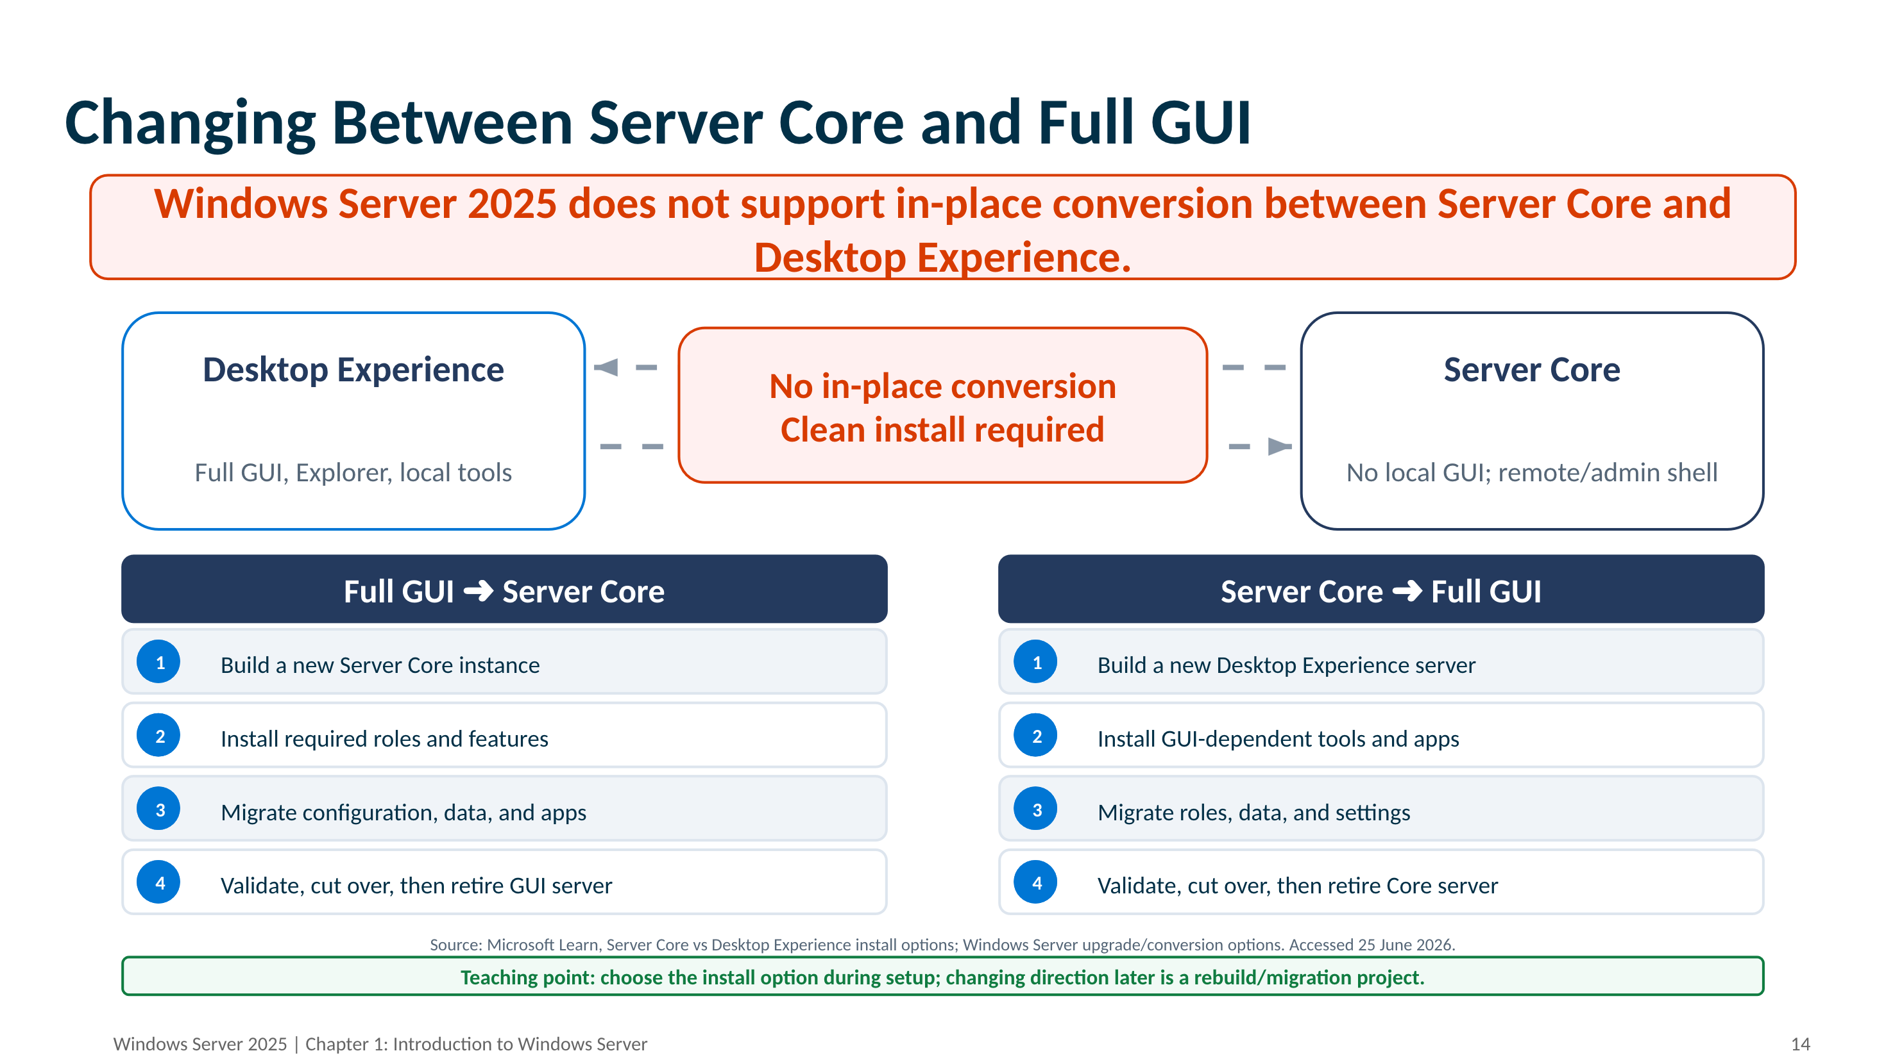

Slide 18
SConfig - Server Configuration Tool
SConfig (Server Configuration Tool) is a text-based menu utility built into Windows Server. It auto-launches on Server Core (2022+) and lets admins perform common tasks without a GUI. Type sconfig in PowerShell to launch. Requires local Administrator privileges.
Menu Options
1
Domain / Workgroup Join or leave an AD domain or workgroup
9
Date & Time Set system date, time, and timezone
2
Computer Name Rename the server (restart required)
10
Telemetry Settings Control diagnostic data sent to Microsoft
3
Add Local Administrator Grant a user local admin rights
11
Windows Activation Enter product key or check activation
4
Remote Management Enable/disable WinRM remote management
12
Log Off User Sign out the current user
5
Windows Update Settings Set automatic or manual update mode
13
Restart Server Reboot the server
6
Download & Install Updates Trigger a manual Windows Update check
14
Shut Down Server Power off the server
7
Remote Desktop Enable or disable RDP access
15
Exit to PowerShell Close SConfig, return to PS prompt
8
Network Settings Configure IP, subnet, gateway, and DNS
Windows Server 2025 | Chapter 1: Introduction to Windows Server
14

Slide 19
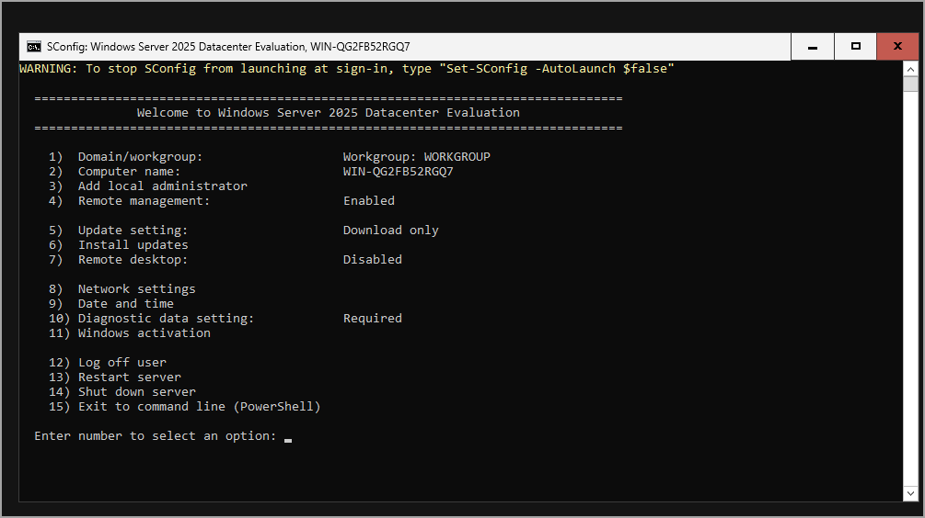
SConfig in Windows Server 2025
Windows Server 2025 | Chapter 1: Introduction to Windows Server
15

Slide 20
Topic 1.3 | Services

Slide 21

1.3 Services: Why They Matter
Services run server functions in the background
They do not require an interactive sign-in
Many roles and applications depend on them
Service health often explains wider platform symptoms
Administrators troubleshoot services constantly — even when the issue appears elsewhere
Windows Server 2025 | Chapter 1: Introduction to Windows Server
17

Slide 22
Service Control Manager Overview
SCM (services.exe) starts via Wininit during boot
Acts as an RPC server for local & remote management
Maintains the ServicesActive database in the registry
HKLM\SYSTEM\CurrentControlSet\Services
Stores type, startup type, path, dependencies, account
Controls service lifecycle & states
States: Running, Stopped, Paused, Pending transitions
Control codes: START, STOP, PAUSE, CONTINUE, INTERROGATE
Resolves dependencies before starting services
DependOnService / DependOnGroup registry values enforced
Managed via services.msc, sc.exe, and PowerShell
OpenSCManager → OpenService / CreateService
ControlService / QueryServiceStatus / StartService
Boot
Wininit.exe → services.exe
▼
SCM Starts
Reads ServiceGroupOrder\List
▼
Reads Service Config
HKLM\...\Services registry key
▼
Starts Required Services
Resolves DependOnService / DependOnGroup
▼
Admin Tools Query & Control
sc.exe, services.msc, PowerShell
Windows Server 2025 | Chapter 1: Introduction to Windows Server
18

Slide 23
Service Administration Concepts
Service status is not the same as startup type
Dependencies affect troubleshooting
Service accounts affect security and startup success
Server Manager, services.msc, PowerShell, and sc.exe all have different value
Recovery settings and startup configuration can be just as important as the current running state
Windows Server 2025 | Chapter 1: Introduction to Windows Server
19

Slide 24
Managing Services with PowerShell
# Check WinRM service state
Get-Service WinRM
# View WinRM dependencies
Get-Service WinRM -RequiredServices
# Set startup type
Set-Service -Name WinRM -StartupType Automatic
# Test a restart safely (WhatIf)
Restart-Service -Name WinRM -WhatIf
# Query config with sc.exe
sc.exe qc WinRM
Windows Server 2025 | Chapter 1: Introduction to Windows Server
20

Slide 25

Services: Common Mistakes to Avoid
Restarting services without checking dependencies
Disabling services without understanding role impact
Assuming Server Manager exposes all service properties
Ignoring service account and permission issues
Confusing a service symptom with the root cause in networking, identity, certs, or storage
Windows Server 2025 | Chapter 1: Introduction to Windows Server
21

Slide 26
Topic 1.4 | Windows Server Architecture

Slide 27
1.4 Windows Server Architecture
Windows Server is a layered platform — not only a role host
Roles and features sit on top of the core operating system
Management, security, networking, storage, and identity interact across the platform
Architectural awareness improves troubleshooting and design decisions
Identity
& Security
Networking
Windows Server
Core OS
Storage
Management
& Automation
Roles, Features & Applications
Windows Server 2025 | Chapter 1: Introduction to Windows Server
23

Slide 28
Chapter Summary
01 Windows Server is a managed workload platform
02 Security is layered and begins with platform trust
03 Services underpin both infrastructure and applications
04 Good administration is design-led, not tool-led
05 Early platform decisions shape later management, troubleshooting, and security outcomes
Windows Server 2025 | Chapter 1: Introduction to Windows Server
25

